Slide 1

Healthcare Data Challenge
Kevin goh
August 2021

Slide 2
The Problem
We have clinical and financial data of patients hospitalized for a certain condition
There are several factors that can affect the cost of care
As such, we want to find insights about the drivers of cost of care for patients of this condition
Objective: To determine the key drivers of cost of care for patients hospitalized

Slide 3
Proposed Approach
Exploratory Data Analysis
Dimensionality Reduction
Model Development
Hyperparameter Tuning
Conclusions & Recommendations
Perform EDA on the dataset to understand the underlying distributions and visualize data | Perform PCA and tSNE on dataset to find clusters in the data and understand which features contribute most to the variance of the cost of care (the variable amount) | Train machine learning models (e.g. linear regression model, decision tree, random forest etc) that predicts the numerical output variable amount | Tune hyperparameters to improve the model | Conclude on the key drivers of the cost of care. Provide recommendations on the deployment of a model for prediction and the way ahead for further data collection for model improvement

Slide 4
Exploratory Data Analysis (Part 1 – Data Preparation)
Data was taken from four csv files with its variables listed below
Bill_amount.csv
Bill_id.csv
Clinical_data.csv
Demographics.csv
bill_id amount | bill_id patient_id date_of_admission | id date_of_admission date_of_discharge medical_history_(1-7) preop_medication_(1-6) symptom_(1-5) lab_result_(1-3) weight height | patient_id gender race resident_status date_of_birth

Slide 5
Exploratory Data Analysis (Part 1 – Data Preparation)
Dataframes from the four csvs were read and merged into a final dataframe named data
bill_amt
bill_id
clinical_data
demographics
bill
data

Slide 6
Exploratory Data Analysis (Part 1 – Data Preparation)
Observation 1 (Mapping between bill and clinical_data):
There is no one-to-one mapping between bill and clinical_data. For certain patients, there were multiple bill records for a particular date of admission while there was only one record in the clinical data for that date.
In order to merge the two dataframes, bill was grouped by ‘patient_id’ and ‘date_of_admission’, taking the sum of the total bill for the entire duration of hospital treatment.
Observation 2 (Missing values):
The were missing values in ‘medical_history_2’ and ‘medical_history_5’ in clinical_data. The corresponding rows of the dataset were removed instead of imputing values.
After removal of missing values, there were a total of 2898 data entries in the dataframe data.
Observation 3 (Non-essential features):
Once all the dataframes were merged, the features ‘id’, ‘bill_id’, and ‘patient_id’ were removed from data as they did not provide useful information

Slide 7
Exploratory Data Analysis (Part 1 – Data Preparation)
Observation 4 (Non-consistent Data):
There were non-consistent data in ‘gender’, ‘race’ and ‘resident_status’ as categories were entered in different representations (e.g. ‘Male’ and ‘m’, ‘Female’ and ‘f’, ‘Chinese’ and ‘chinese’, ‘Indian’ and ‘India’)
Data cleaning was performed to ensure consistency
Observation 5 (Date Features):
There were three date features which could be engineered to provide better insights
Two features were created – ‘days_admitted’ and ‘age’
‘days_admitted’ – difference between date of admission and discharge
‘age’ – difference between date of admission and date of birth
With the two new features created, the original date features were dropped

Slide 8
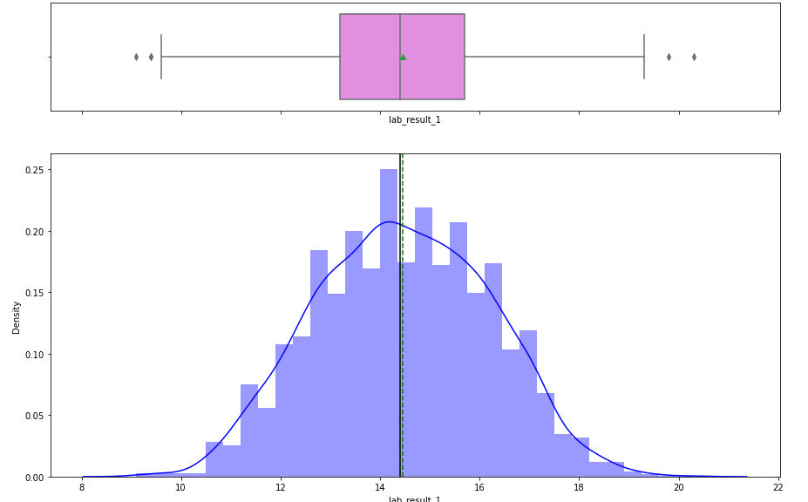
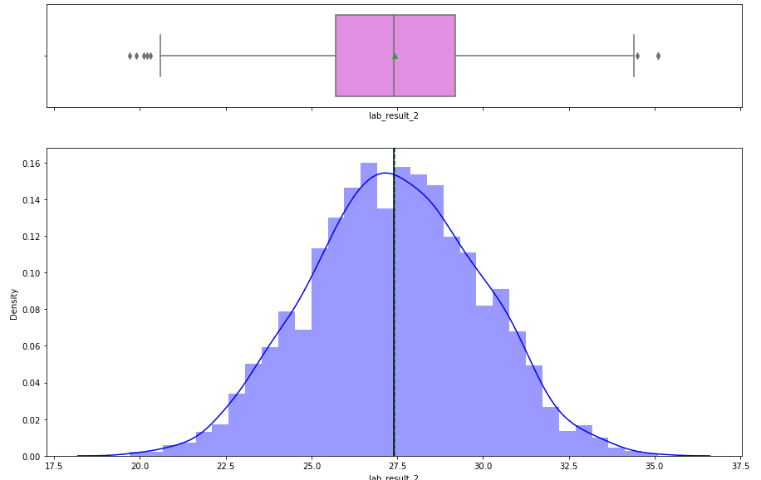
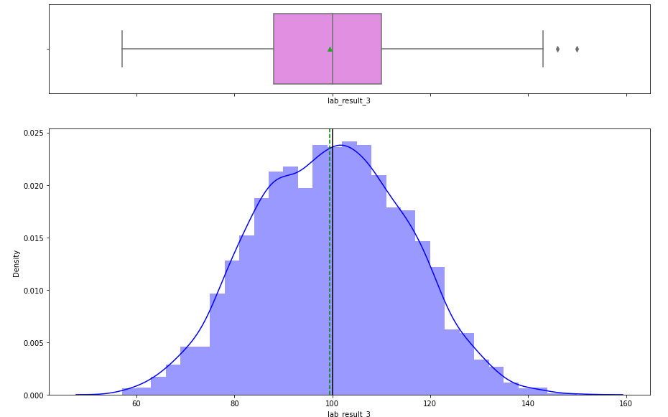
Exploratory Data Analysis (Part 2 – Univariate Analysis [Numerical Variables])
lab_result_1 | lab_result_2 | lab_result_3
Observation: Lab results are normally distributed with few outliers

Slide 9
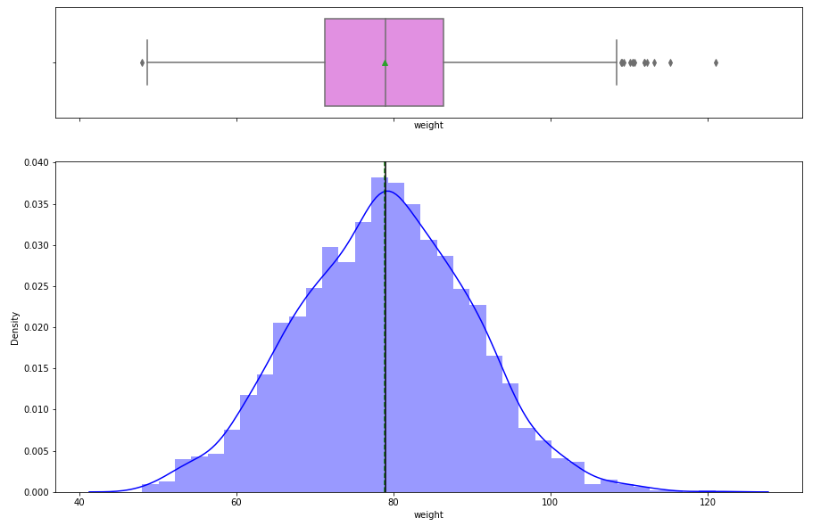
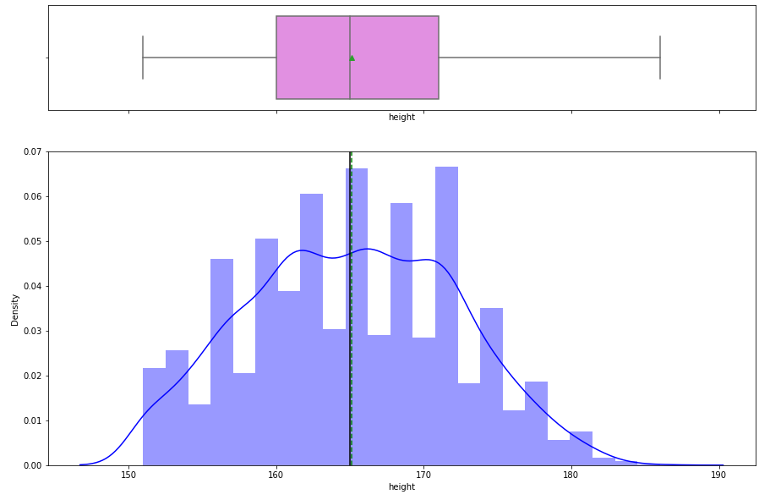
Exploratory Data Analysis (Part 2 – Univariate Analysis [Numerical Variables])
weight | height
Observation: Weight and Height are normally distributed with few outliers

Slide 10
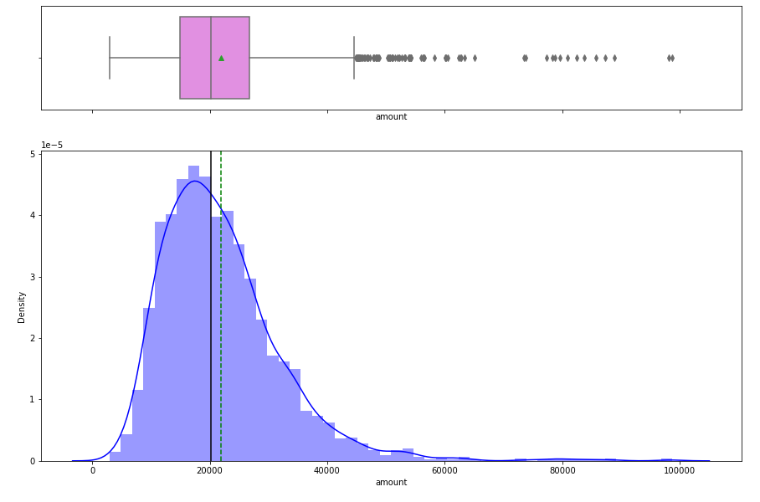
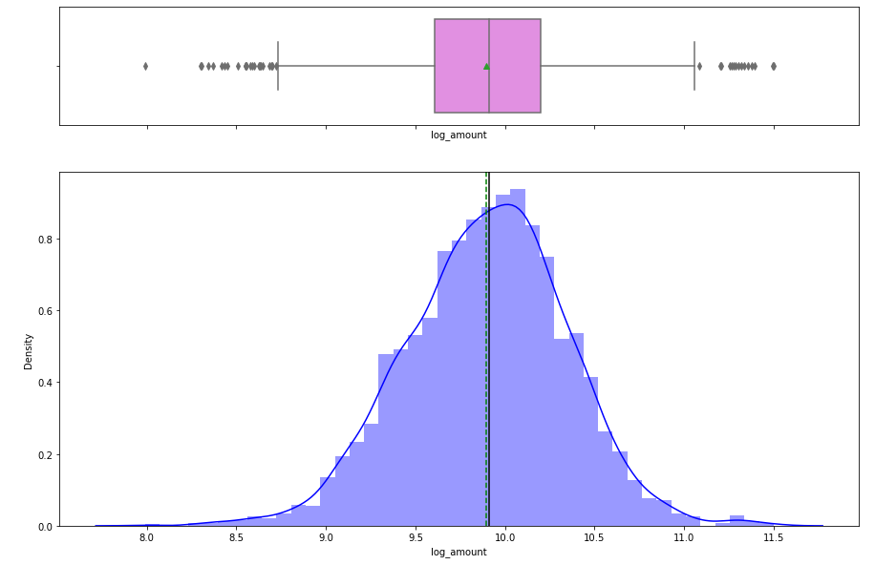
Exploratory Data Analysis (Part 2 – Univariate Analysis [Numerical Variables])
amount | log_amount
Observation: Amount is right-skewed. After log transformation, the skew is reduced.

Slide 11
Exploratory Data Analysis (Part 2 – Univariate Analysis [Numerical Variables])
amount | log_amount
Observation: Amount is right-skewed. After log transformation, the skew is reduced.

Slide 12
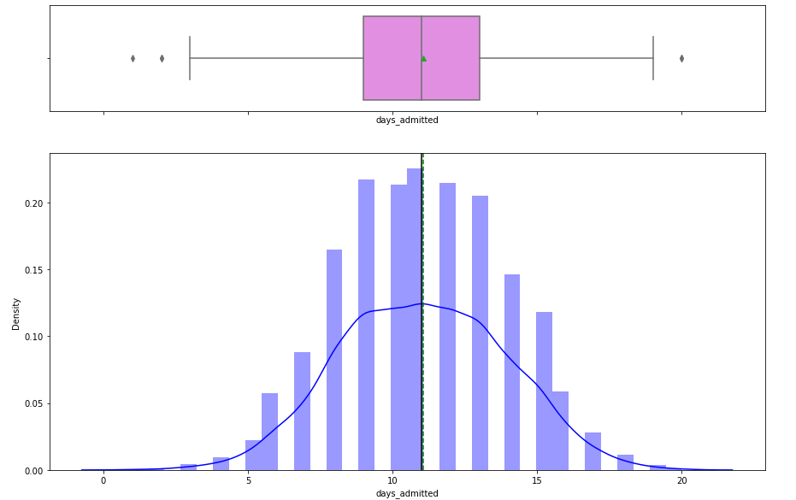
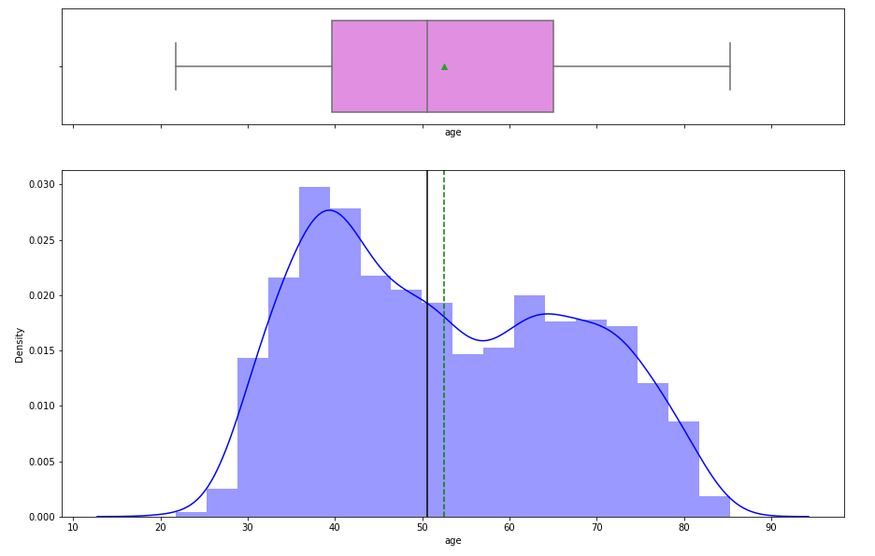
Exploratory Data Analysis (Part 2 – Univariate Analysis [Numerical Variables])
days_admitted | age
Observation: days_admitted is normally distributed while age is not.

Slide 13
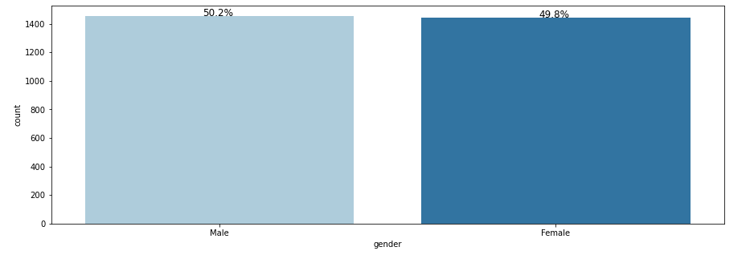
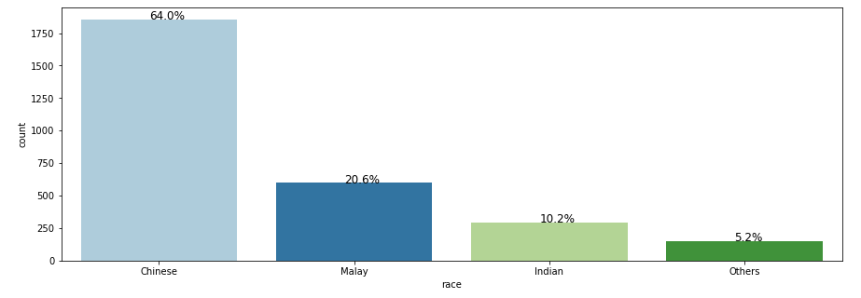
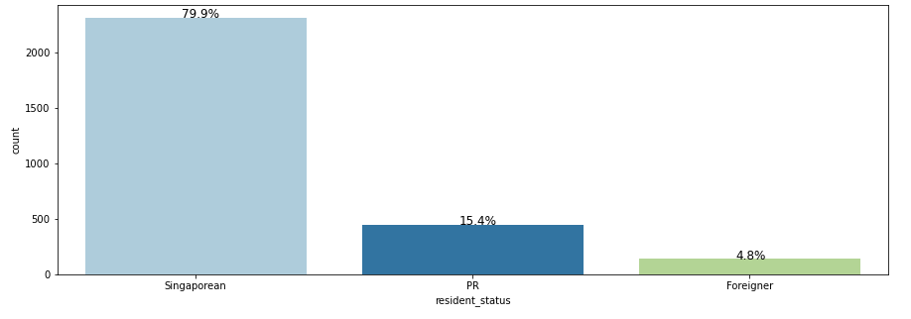
Exploratory Data Analysis (Part 2 – Univariate Analysis [Categorical Variables])
gender | race
Observation (of proportions):
Male and females are almost equal
Majority race is ‘Chinese’
Majority resident status is Singaporean
resident_status

Slide 14
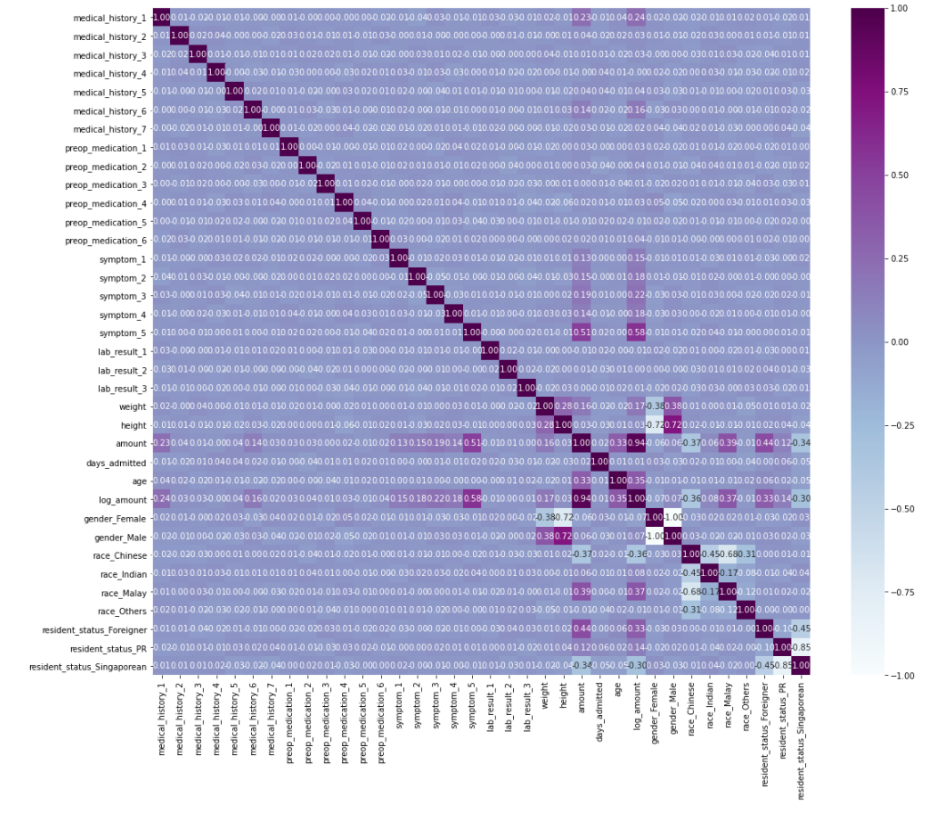
Exploratory Data Analysis (Part 3 – Bivariate Analysis [Numerical Variables])
* Expected high correlation due to log transformation
Observation: The top five variables with high correlation with log_amount are ‘symptom_5’, ‘race_Malay’, ‘race_Chinese’, ‘age’, ‘resident_status_Foreigner’

Slide 15
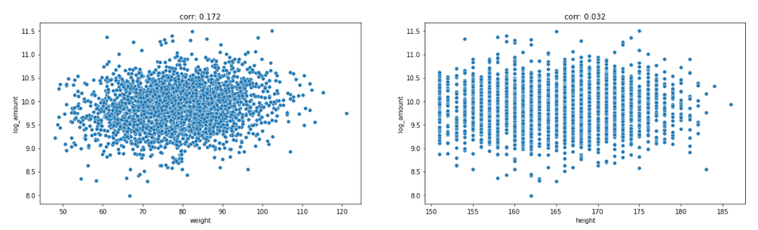
Exploratory Data Analysis (Part 3 – Bivariate Analysis [Numerical Variables])
Observation: weight has low-moderate correlation (0.172) with log_amount,
height has low correlation (0.032) with log_amount

Slide 16
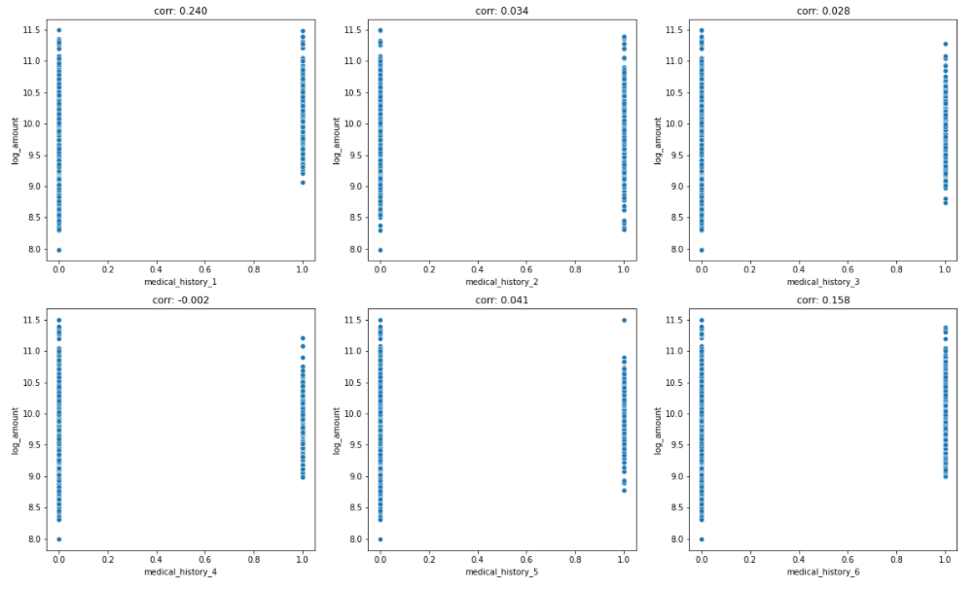
Exploratory Data Analysis (Part 3 – Bivariate Analysis [Binary Variables])
Observation: Order of correlation (descending): medical_history_1, medical_history_6, medical_history_5, medical_history_2, medical_history_3, medical_history_4

Slide 17
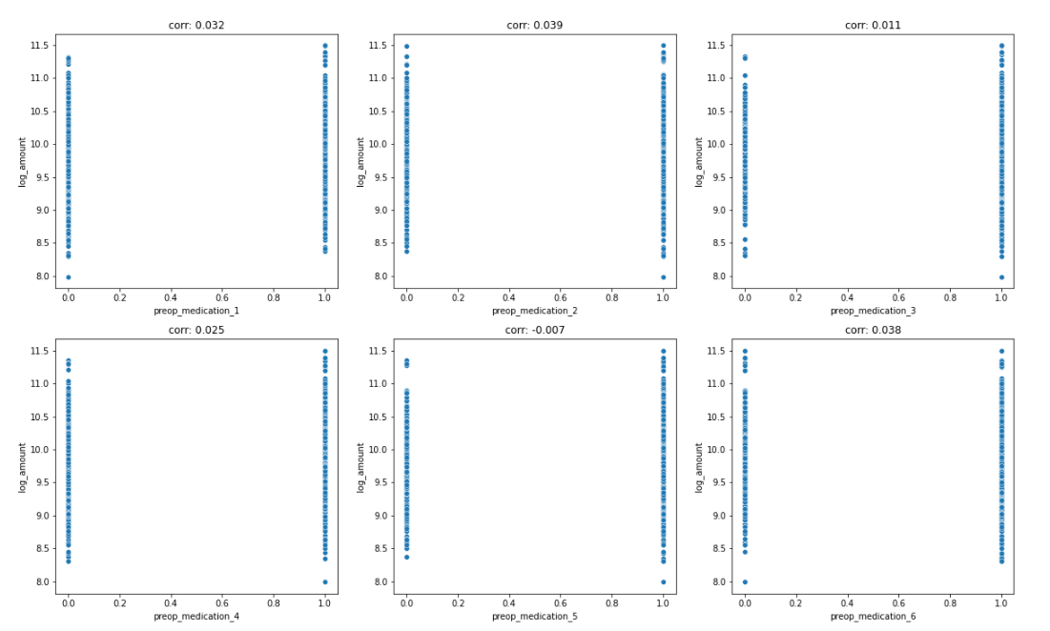
Exploratory Data Analysis (Part 3 – Bivariate Analysis [Binary Variables])
Observation: Order of correlation (descending): preop_medication_2, preop_medication_6, preop_medication_1, preop_medication_4, preop_medication_3, preop_medication_5

Slide 18
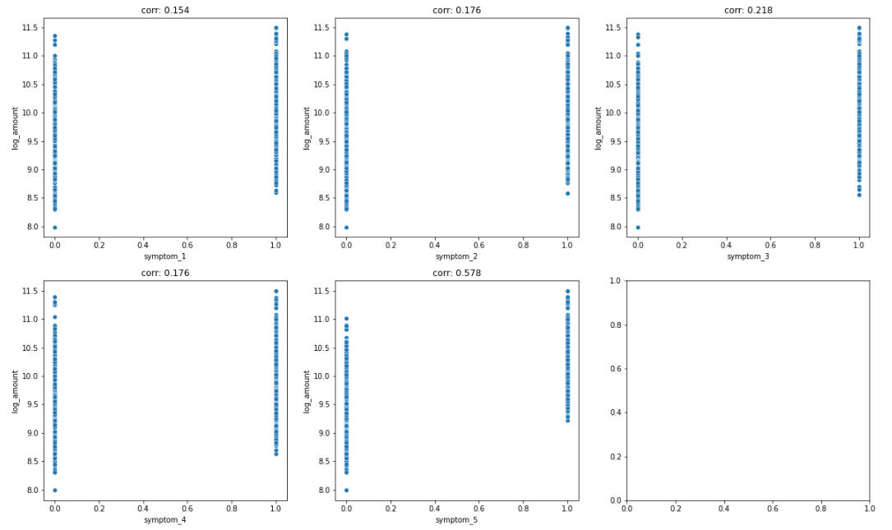
Exploratory Data Analysis (Part 3 – Bivariate Analysis [Binary Variables])
Observation: Order of correlation (descending): symptom_5, symptom_3, symptom_2, symptom_4, symptom_1

Slide 19
Exploratory Data Analysis Key Insights
Insight 1 (Distributions of Numerical Variables):
Numerical variables are observed to be normally distributed except for ‘age’ and ‘amount’
‘Amount’ was log transformed and ‘log_amount’ will be used as the output variable
Insight 2 (Proportions of Race and Resident Status):
Majority race is ‘Chinese’ (64.0%)
Majority resident status is Singaporean (79.9%)
Insight 3 (Medical history, Preop Medication, and Symptoms):
Symptoms are generally low to moderately correlated with log_amount (0.154 to 0.578)
‘Medical_history_1’ (0.240) and ‘Medical_history_6’ (0.158) have low correlation with log_amount

Slide 20
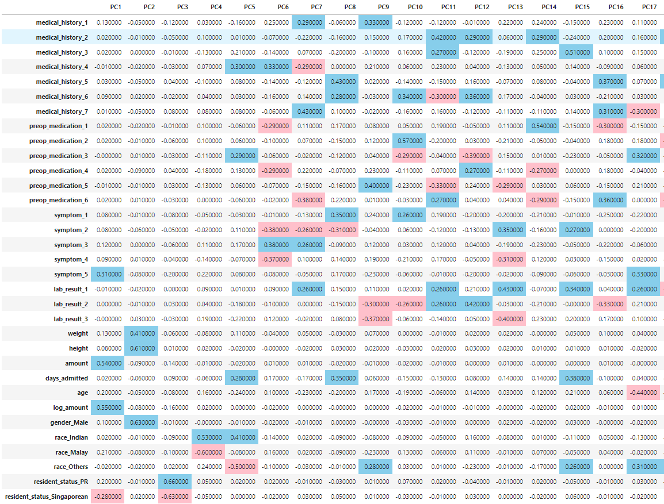
Dimensionality Reduction (Part 1 – PCA)
Methodology
PCA was performed on the dataset to reduce dimensionality and determine key features through principal components
In order to capture 70% of the variance, it was found that 19 PCs were required

Slide 21
Dimensionality Reduction (Part 1 – PCA)
Observation 1 (Principal Component with Amount and Log_Amount):
The first Principal Component is positively related with ‘symptom_5’, ‘amount’ and ‘log_amount’ and negatively correlated with ‘resident_status_Singaporean’
This captures the observation that those with ‘symptom_5’ are related to higher amounts
It also captures that those who are Singaporean are related to lower amounts
Conclusion from PCA: symptom_5 and resident_status_Singaporean are important features to predict amount and log_amount
Observation 2 (No other PC with Amount and Log_Amount):
There are no other PCs with ‘Amount’ and ‘Log_Amount’

Slide 22
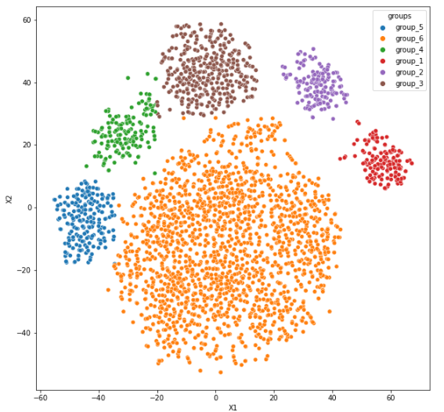
Dimensionality Reduction (Part 2 – tSNE)
Methodology
tSNE was performed on the dataset to reduce dimensionality to 2 components and find clusters in the datset
Multiple values of the parameter ‘perplexity’ were used and it was observed that a value of 35 produced good clusters with a total of 6 groupings

Slide 23
Dimensionality Reduction (Part 2 – tSNE)
Observation 1 (Characteristics of Groups):
It was found that the groups could be differentiated by the resident status, race, medical history or symptoms
Group 1: No medical_history_6
Group 2: medical_history_4, no medical_history_6
Group 3: symptom_4
Group 4: medical_history_5
Group 5: No medical_history_6
Group 6: Largest variance in weight, height, amount and days_admitted
While Group 6 had the largest variance in amount, the group was not immediately differentiable by features

Slide 24
Dimensionality Reduction Key Insights
Insight 1 (Symptom_5 and Resident_Status_Singaporean)
The largest variance of the dataset, explained by PC1 in PCA, is positively related with ‘symptom_5’, ‘amount’ and ‘log_amount’ and negatively correlated with ‘resident_status_Singaporean’
‘symptom_5’ and ‘resident_status_Singaporean’ are important features to predict ‘amount’ and ‘log_amount’

Slide 25
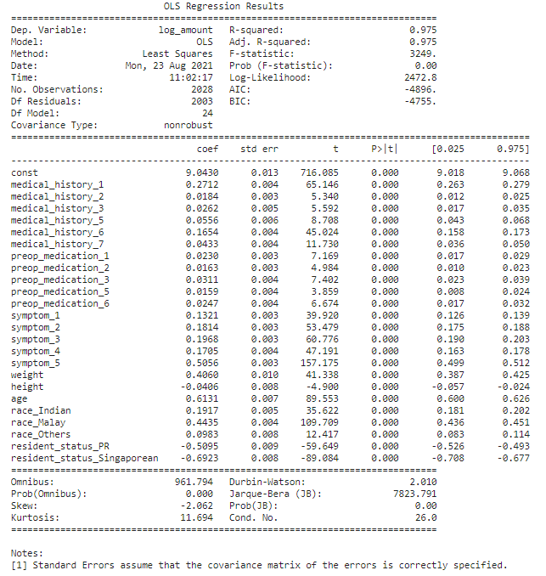
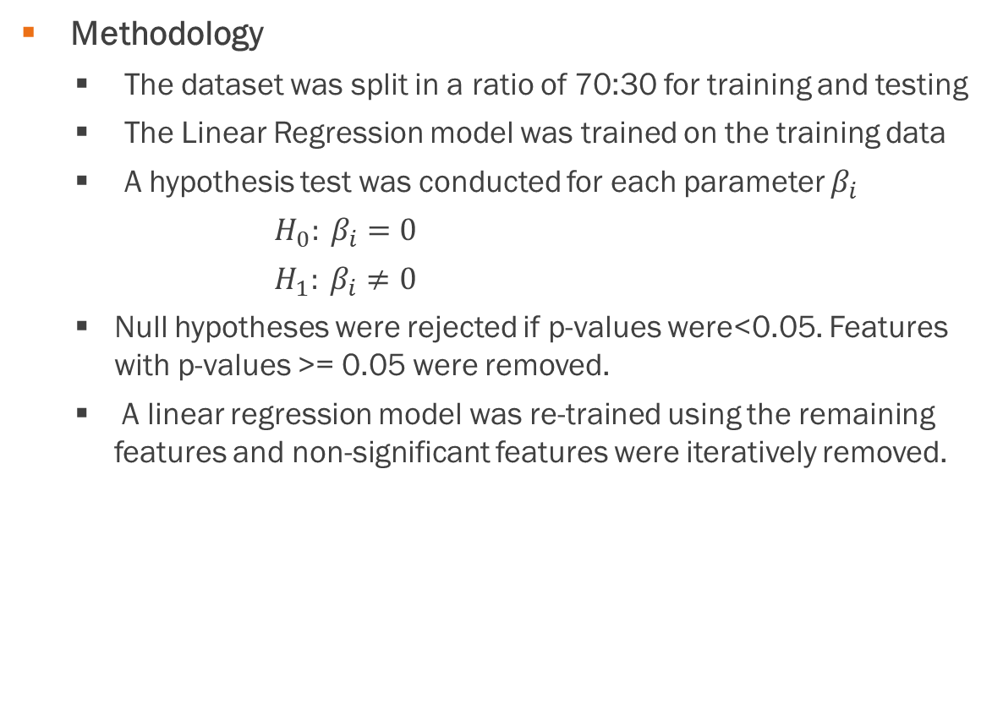
Model Development Linear Regression Model
Methodology
The dataset was split in a ratio of 70:30 for training and testing
The Linear Regression model was trained on the training data
A hypothesis test was conducted for each parameter $β_{i}$
$H_{0}: β_{i}=0$
$H_{1}: β_{i}≠0$
Null hypotheses were rejected if p-values were<0.05. Features with p-values >= 0.05 were removed.
A linear regression model was re-trained using the remaining features and non-significant features were iteratively removed.

Slide 26
Model Development Linear Regression Model
 | R² | MAE | RMSE
Linear Regression (on training data) | 0.975 | 0.051 | 0.071
Linear Regression (on test data) | 0.966 | 0.063 | 0.082
Findings
The final linear regression model (ols_res_2) fits the data well with high R2 scores and low errors on both training and test data
There were a total of 24 features in the final model
Model was tested for assumptions and fulfilled:
No multicollinearity between variables
Zero mean of residuals
Normality of residuals
Linearity of residuals
Homoskedasticity

Slide 27
Model Development Linear Regression Model
 | R² | MAE | RMSE
Linear Regression (on training data) | 0.975 | 0.051 | 0.071
Linear Regression (on test data) | 0.966 | 0.063 | 0.082
Findings
The most significant features of the model were (sorted in descending t stat values):
Symptom_5
Race_Malay
Age
Resident_status_Singaporean
Medical_history_1

Slide 28
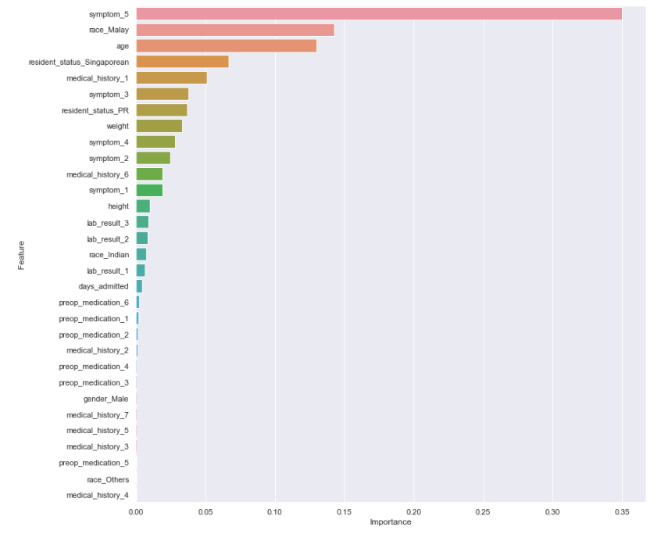
Model Development Decision Tree Regressor
 | R² | MAE | RMSE
Decision Tree (on training data) | 1.000 | 0.000 | 0.000
Decision Tree (on test data) | 0.762 | 0.162 | 0.216
Methodology
The dataset was split in a ratio of 70:30 for training and testing (using the same split in the linear regression model)
DecisionTreeRegressor was trained on the training data and tested on test data
Findings
The model had a R2 of 1.000 and no errors on the training data.
The model did not perform well on test data with significantly lower R2 score of 0.762 and higher errors.
The model was assessed to be overfitting the data.

Slide 29
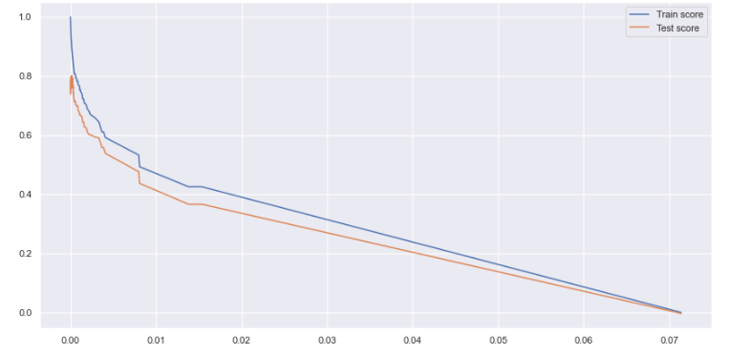
Model Development Decision Tree Regressor (Tuned)
Methodology
The Decision Tree was regularized through hyperparameter tuning by iterating through alphas from the cost complexity pruning path
The alpha corresponding to the highest test score was used for the tuned decision tree
Findings
After regularization, the model performed better on the test data with R2 score of 0.797 and MAE of 0.154 and RMSE of 0.200
It also performed less well on training data
Highest test score
 | R² | MAE | RMSE
Dtree_Tuned (on training data) | 0.893 | 0.117 | 0.148
Dtree_Tuned (on test data) | 0.797 | 0.154 | 0.200

Slide 30
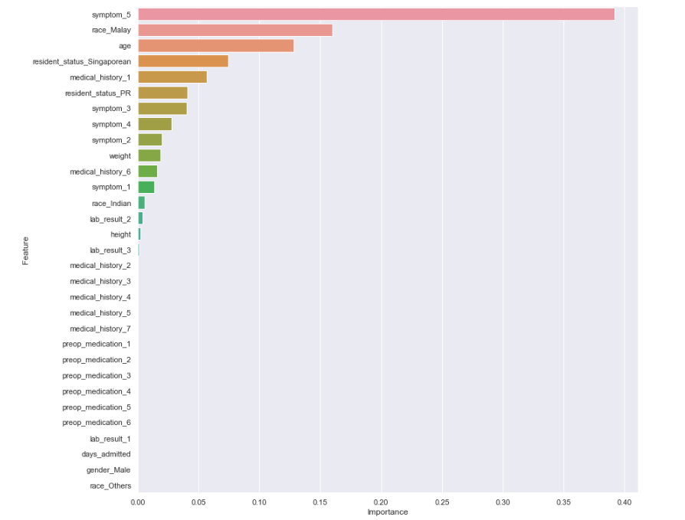
Model Development Decision Tree Regressor (Tuned)
 | R² | MAE | RMSE
Dtree_Tuned (on training data) | 0.893 | 0.117 | 0.148
Dtree_Tuned (on test data) | 0.797 | 0.154 | 0.200
Findings
There were a total of 16 features in the tuned decision tree model
The top five features of Dtree_Tuned were:
Symptom_5
Race_Malay
Age
Resident_status_Singaporean
Medical_history_1

Slide 31
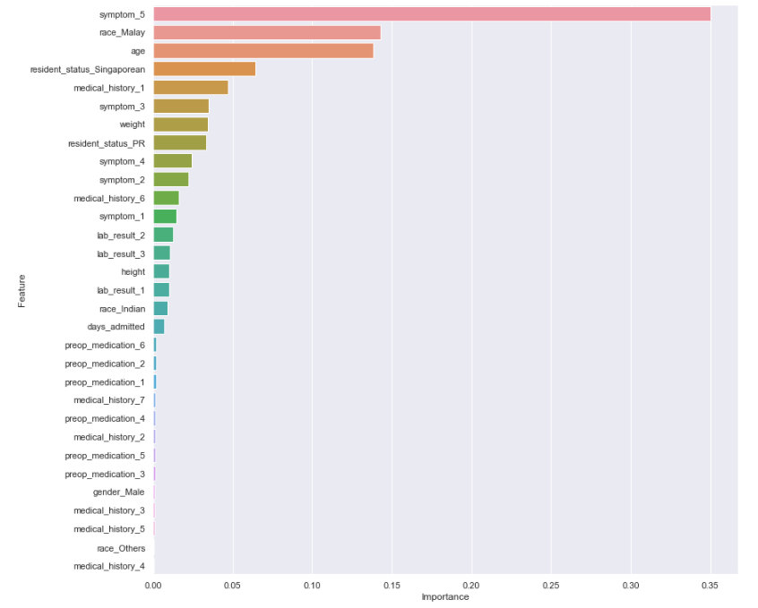
Model Development Random Forest Regressor
 | R² | MAE | RMSE
Random Forest (on training data) | 0.985 | 0.041 | 0.056
Random Forest (on test data) | 0.877 | 0.113 | 0.155
Methodology
The dataset was split in a ratio of 70:30 for training and testing (using the same split in the linear regression model)
RandomForestRegressor was trained on the training data and tested on test data
Findings
Compared to the decision tree model, the random forest before tuning already performs better than dtree_tuned
However, it does not perform as well as the linear regression model

Slide 32

Model Development Random Forest Regressor (Tuned)
 | R² | MAE | RMSE
Rf_tuned (on training data) | 0.980 | 0.046 | 0.064
Rf_tuned (on test data) | 0.881 | 0.111 | 0.153
Methodology
Randomised search was first performed using RandomisedSearchCV which indicated in the best parameters that ‘max_depth’ was ‘None’.
GridSearchCV was used for hyperparameter tuning over ‘min_samples_leaf’, ‘min_samples_split’ and ‘n_estimators’.
Findings
The tuned random forest performs better than the decision tree (both tuned and untuned).
The top five features are the same as the decision tree

Slide 33
Model Development Summary of Results
 | R² | MAE | RMSE | Features
TRAINING
Linear Regression (on training data) | 0.975 | 0.051 | 0.071 | 24
Decision Tree (on training data) | 1.000 | 0.000 | 0.000 | 31
Dtree_Tuned (on training data) | 0.893 | 0.117 | 0.148 | 16
Random Forest (on training data) | 0.985 | 0.041 | 0.056 | 31
Rf_tuned (on training data) | 0.980 | 0.046 | 0.064 | 24
TESTING
Linear Regression (on test data) | 0.966 | 0.063 | 0.082 | 24
Decision Tree (on test data) | 0.762 | 0.162 | 0.216 | 31
Dtree_Tuned (on test data) | 0.797 | 0.154 | 0.200 | 16
Random Forest (on test data) | 0.877 | 0.113 | 0.155 | 31
Rf_tuned (on test data) | 0.881 | 0.111 | 0.153 | 31
Conclusion: Decision Tree is overfitting the training data. The best overall model is the linear regression model which performs well on both training and test data.

Slide 34
Key Insights
Key Insight 1 (Medical history and Symptoms):
Symptoms are generally low to moderately correlated with log_amount (0.154 to 0.578)
‘Medical_history_1’ (0.240) and ‘Medical_history_6’ (0.158) have low correlation with log_amount
Key Insight 2 (Symptom_5 and Resident_Status_Singaporean)
‘symptom_5’ and ‘resident_status_Singaporean’ are important features to predict ‘amount’ and ‘log_amount’
Key Insight 3 (Linear Regression Model fits data best)
The linear regression model is the best overall model
The data can be described by a linear model. Non-linear models such as decision trees and random forests do not perform very well on the data.

Slide 35
Key Insights
Key Insight 4 (The top 5 features)
The top five features across models are same: ‘Symptom_5’, ‘Race_Malay’, ‘Age’, ‘Resident_status_Singaporean’, ‘Medical_history_1’
Key Insight 5 (Features excluded from Linear Regression model)
There are 7 features excluded from the linear regression model:
Medical_history_4
Preop_medication_4
Lab_result_1 to Lab_result_3
Days_admitted
Gender_Male

Slide 36
Conclusions
Key Drivers of Cost of Care (in descending order):
Symptom_5
Race_Malay
Age
Resident_status_Singaporean (drives cost negatively)
Medical_history_1

Slide 37
Recommendations
Determining Causality: It is important to note that correlation does not imply causation and further study must be done to understand if there are latent variables. While the linear regression model predicts that certain races or resident status have higher cost of care, there could be existence of latent confounding variables which are not featured in the data set (e.g. being of a particular resident status could mean additional taxes or fees, or possibly a different lifestyle that leads to different symptoms but this may not be captured in the dataset).
Data Harvesting: More data is required to build better models as the current dataset is limited to only 2898 entries.
Data Inputs: each bill could be correlated to certain treatments to provide a one-to-one mapping between bill and clinical_data
Adding features: More features can be added to provide more insight
Model Development: Further model refinement can be done on the random forest model to explore if it is possible to improve performance of non-linear models

